Slide 1
Bunny Run
By
Natcha Jengjirapas
Kevin Ly
Jordell Rodrigues

Slide 2
What game did we make? (Purpose)
We made an endless runner style game, similar to CookieRun, where a player controls a bunny using the spacebar. Your goal is to get as many points as possible without dying, you can earn points by collecting the coins and staying alive.

Slide 3

Resources used?
We created our game using in Unity using the language C# instead of java. We watched youtube videos and online tutorials to help make our game.
https://unity3d.com/learn/tutorials/topics/scripting/lets-make-game-infinite-runner (template game)
https://docs.unity3d.com/Manual/Unity2D.html (How to use unity)

Slide 4
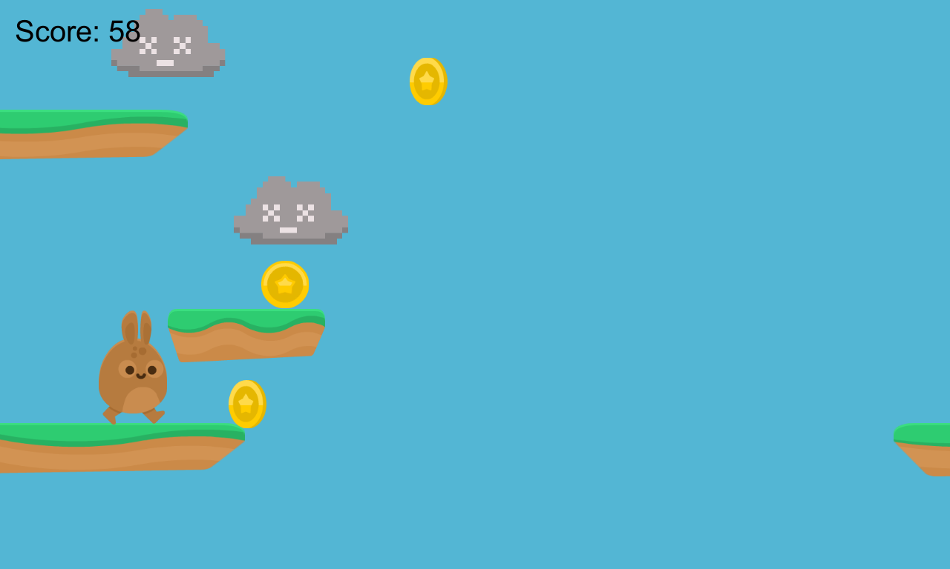

Slide 5
How does our game work? (Process)
Our game starts off on the main menu, using buttons and text we created a main menu that can transition into other scenes. We downloaded some assets and spikes online for the design including pictures in png, sounds and fonts. Our game is in 2D mode and Unity has its own physic which makes it a bit easier to code the Bunny and platforms. (Not really) The bunny makes a noise every time it jumps, the bunny can double jump, and there is music playing the entire game.
Main menu
Game screen
Bunny and items controller / animation
Platforms, Clouds, and Coins
Camera movement
End/ score screen

Slide 6
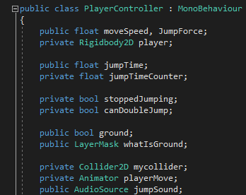
Inheritance && Encapsulation
class PlayerController : MonoBehaviour
public GameObject platformDestroyer;
private GUIStyle guiStyle = new GUIStyle(); (used to change the font size of the score, etc.)
private Animator playerMove;
public AudioSource jumpSound; (referencing an AudioSource that is not part of the script)
public void Quit() (used to exit the game)

Slide 7
Two major logic problems
Adjust to C#
class PlayerController : MonoBehaviour (extend)
using UnityEngine; (import)
Combine all the scenes
Part of the codes reference to different object
Some variables and values are off
Screen did not change as intended

